Slide 1
Session 3
PHP Advanced

Slide 2
Chapter Objectives
Some Build-In Functions :
PHP Date
PHP Include
PHP Cookies
PHP Sessions
PHP Upload
PHP Post
PHP Get

Slide 3
PHP Date
PHP Date / Time Introduction
The date/time functions allow you to extract and format the date and time on the server. These functions depend on the locale settings of the server!
PHP Date - Format the Date
The first parameter in the date() function specifies how to format the date/time. It uses letters to represent date and time formats. Here are some of the letters that can be used:
d - The day of the month (01-31)
m - The current month, as a number (01-12)
Y - The current year in four digits
Other characters, like"/", ".", or "-" can also be inserted between the letters to add additional formatting

Slide 4
Example
Code
<?
echo date("Y/m/d");
echo "<br />";
echo date("Y.m.d");
echo "<br />";
echo date("Y-m-d");
?>
Output
2006/07/11
2006.07.11
2006-07-11

Slide 5
PHP Include File
Server Side Includes (SSI) are used to create functions, headers, footers, or elements that will be reused on multiple pages.
You can insert the content of a file into a PHP file before the server executes it, with the include() or require() function. The two functions are identical in every way, except how they handle errors. The include() function generates a warning (but the script will continue execution) while the require() function generates a fatal error (and the script execution will stop after the error).
<?
include(“header.php”);
include_once(“body.php”);
require(“test.php”);
require_once(“connect.php”);
?>

Slide 6
PHP Cookies
What is a Cookie?
A cookie is often used to identify a user. A cookie is a small file that the server embeds on the user's computer. Each time the same computer requests a page with a browser, it will send the cookie too. With PHP, you can both create and retrieve cookie values.
How to Create a Cookie?
The setcookie() function is used to set a cookie. The setcookie() function must appear BEFORE the <html> tag.

Slide 7
PHP Cookies
Syntax
setcookie(name, value, expire, path, domain);
Example
In the example below, we will create a cookie named "user" and assign the value "Alex Porter" to it.
We also specify that the cookie should expire after one hour:
<? setcookie("user", "Alex Porter", time()+3600); ?>

Slide 8
PHP Cookies
How to Retrieve a Cookie Value?
The PHP $_COOKIE variable is used to retrieve a cookie value.
isset() function to find out if a cookie has been set
When deleting a cookie you should assure that the expiration date is in the past.
<? // Print a cookie echo $_COOKIE["user"];
?>
<? if (isset($_COOKIE["user"])) echo "Welcome " . $_COOKIE["user"] . "!<br/>"; else echo "Welcome guest!<br />"; ?>
<? // set the expiration date to one hour ago setcookie("user", "", time()-3600);
?>

Slide 9
PHP Sessions
A PHP session variable is used to store information about, or change settings for a user session. Session variables hold information about one single user, and are available to all pages in one application.
Sessions work by creating a unique id (UID) for each visitor and store variables based on this UID. The UID is either stored in a cookie or is propagated in the URL.
Starting a PHP Session
Before you can store user information in your PHP session, you must first start up the session. The session_start() function must appear BEFORE the <html> tag.
<? session_start();
?>

Slide 10
PHP Sessions
Storing a Session Variable
The correct way to store and retrieve session variables is to use the PHP $_SESSION variable.
<? session_start(); // store session data $_SESSION['views']=1; ?>
<html> <body>
<?
//retrieve session data
echo "Pageviews=". $_SESSION['views'];
?>
</body> </html>

Slide 11
PHP Sessions
The isset() function checks if the "views" variable has already been set.
Destroying a Session
If you wish to delete some session data, you can use the unset() or the session_destroy() function.
<? isset($_SESSION['views'])
?>
<?
unset($_SESSION['views']);
?>
<?
session_destroy();
?>

Slide 12
PHP File Upload
Use move_uploaded_file() functions
Create an Upload-File Form
<form enctype='multipart/form-data' action='upload.php' method='POST'>
File:<input name='uploaded' type='file'/>
<input type='submit' value='Upload'/>
</form>

Slide 13
PHP File Upload
Create The Upload Script
<?
$target = "test/“. $_FILES['uploaded']['name'] ;
if(move_uploaded_file($_FILES['uploaded']['tmp_name'],$target)) echo "OK!";//$chmod o+rw galleries
?>

Slide 14
PHP Forms and User Input
The PHP $_GET and $_POST variables are used to retrieve information from forms, like user input.
PHP Form Handling
The most important thing to notice when dealing with HTML forms and PHP is that any form element in an HTML page will automatically be available to your PHP scripts.
The PHP $_GET and $_POST variables will be explained in the next slides.

Slide 15
PHP $_GET
The $_GET variable is used to collect values from a form with method="get".
The $_GET Variable
The $_GET variable is an array of variable names and values sent by the HTTP GET method.
The $_GET variable is used to collect values from a form with method="get". Information sent from a form with the GET method is visible to everyone (it will be displayed in the browser's address bar) and it has limits on the amount of information to send (max. 100 characters).

Slide 16
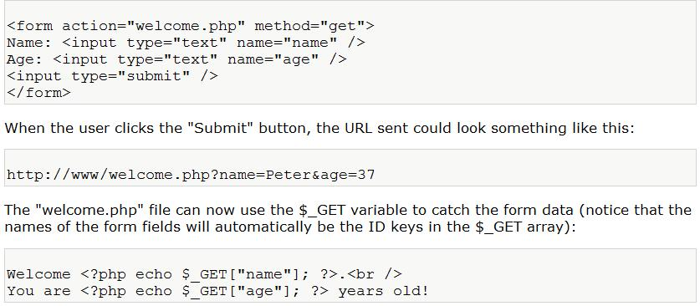
Example

Slide 17
PHP $_POST
The $_POST variable is used to collect values from a form with method="post".
The $_POST Variable
The $_POST variable is an array of variable names and values sent by the HTTP POST method.
The $_POST variable is used to collect values from a form with method="post". Information sent from a form with the POST method is invisible to others and has no limits on the amount of information to send.

Slide 18
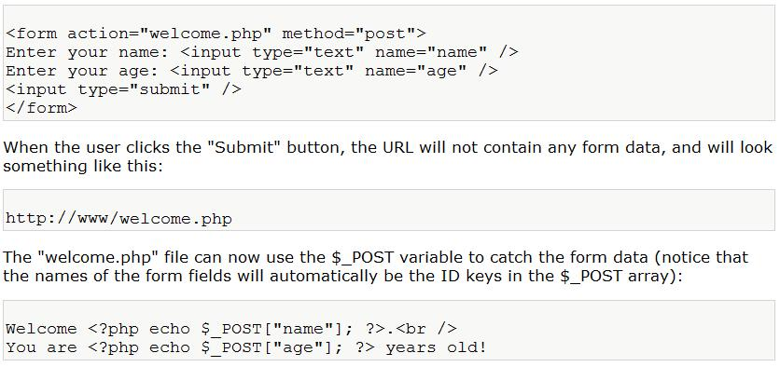
Example

